Slide 1
Chapter 1:
Foundation for Calculus: Functions and Limits
Section 1.5
Trigonometric Functions

Slide 2
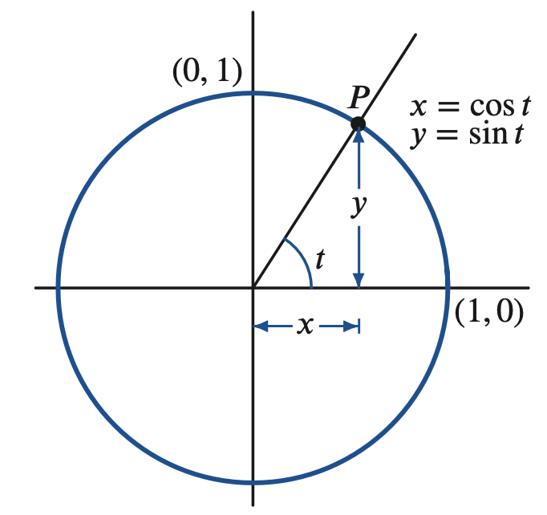
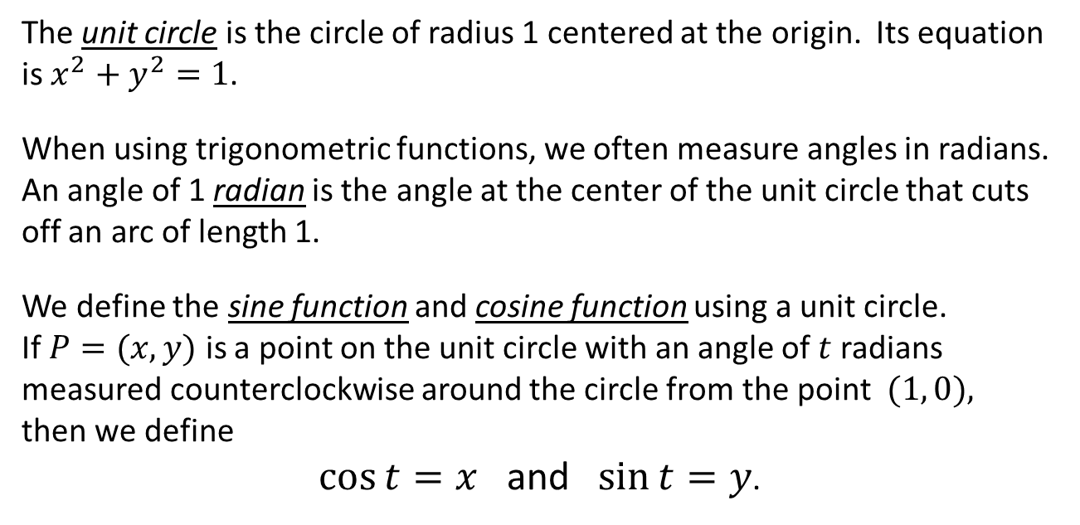
Defining Sine and Cosine
The unit circle is the circle of radius 1 centered at the origin. Its equation is $x^{2}+y^{2}=1$.
When using trigonometric functions, we often measure angles in radians. An angle of 1 radian is the angle at the center of the unit circle that cuts off an arc of length 1.
We define the sine function and cosine function using a unit circle.
If $P=(x, y)$ is a point on the unit circle with an angle of $t$ radians measured counterclockwise around the circle from the point $(1, 0),$
then we define
$\cos{t=x}$ and $\sin{t=y}$.

Slide 3
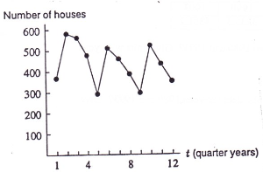
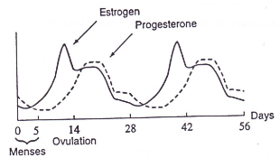
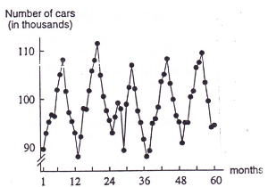
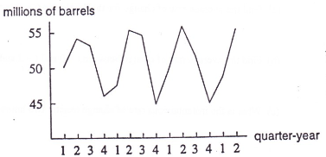
Modeling Oscillating Behavior
There are many great things to say and learn and know about trig functions.
One important use of trig functions is to model oscillating behavior.
Lots of things show oscillating behavior!
Hormones in ovulating females
Housing Construction Starts
Traffic on the Golden Gate Bridge
Quarterly beer production

Slide 4
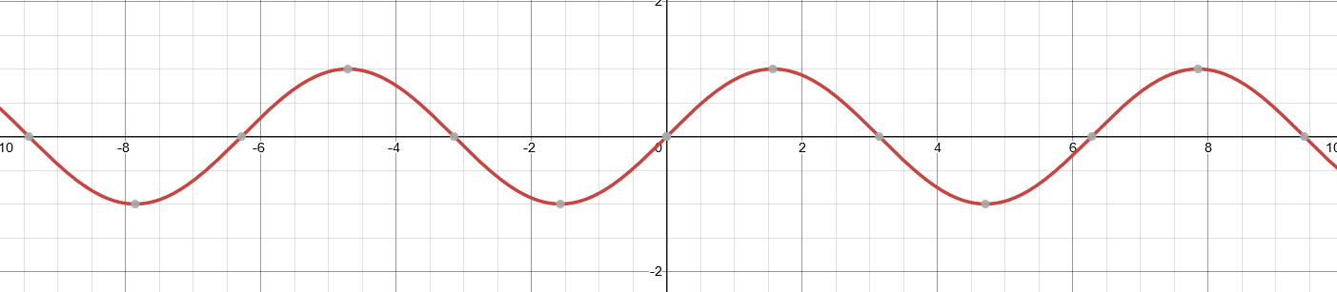
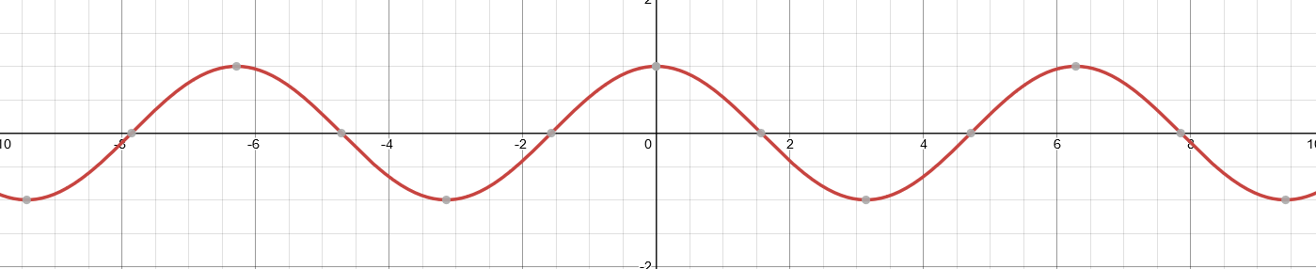
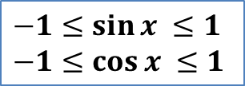
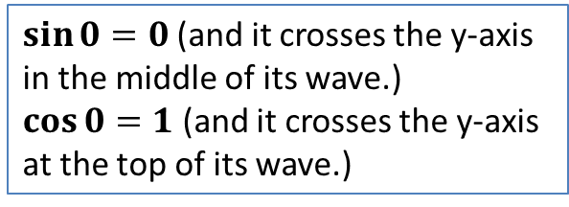




Graphs of $y=\sin{x}$ and $y=\cos{x}$
$$y=\sin{x}$$
$$y=\cos{x }$$
$\sin{0}=0$(and it crosses the y-axis in the middle of its wave.)
$\cos{0}=1$ (and it crosses the y-axis at the top of its wave.)
$−1≤\sin{x} ≤1$
$−1≤\cos{x} ≤1$
When doing calculus involving trig functions, the argument should always be in radians (not degrees).
${(\sin{x})}^{2}+{(\cos{x})}^{2}=1$

Slide 5
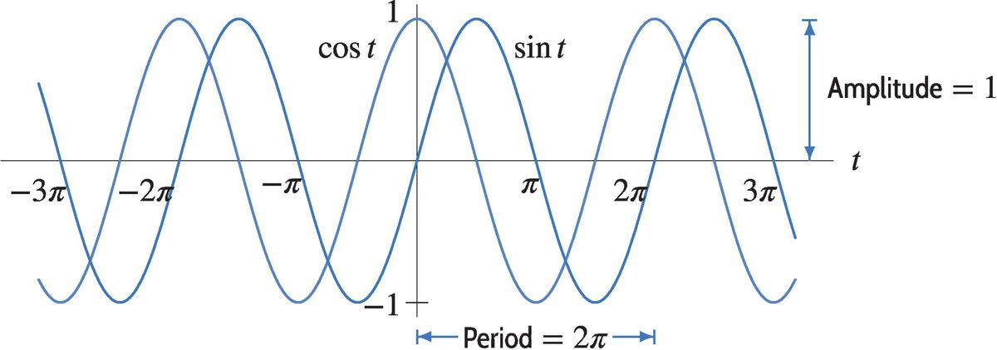
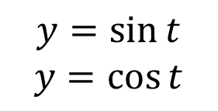
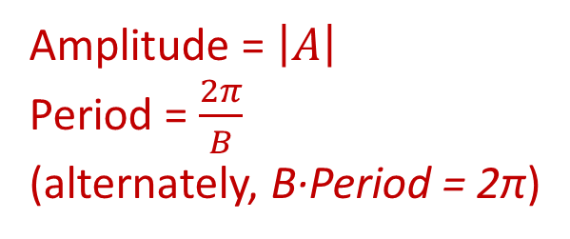
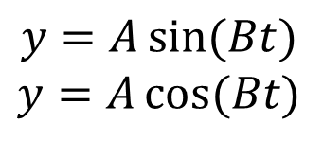
Amplitude and Period
The amplitude is the distance the wave goes up and down from the midline.
The period is the smallest time needed for the wave to include one complete cycle.
$$y=\sin{t}$$
$$y=\cos{t}$$
$$y=A\sin{(Bt)}$$
$$y=A\cos{(Bt)}$$
Amplitude = $\left|A\right|$
Period = $\frac{2π}{B}$
(alternately, B·Period = 2π)
Amplitude = 1
Period = 2π

Slide 6
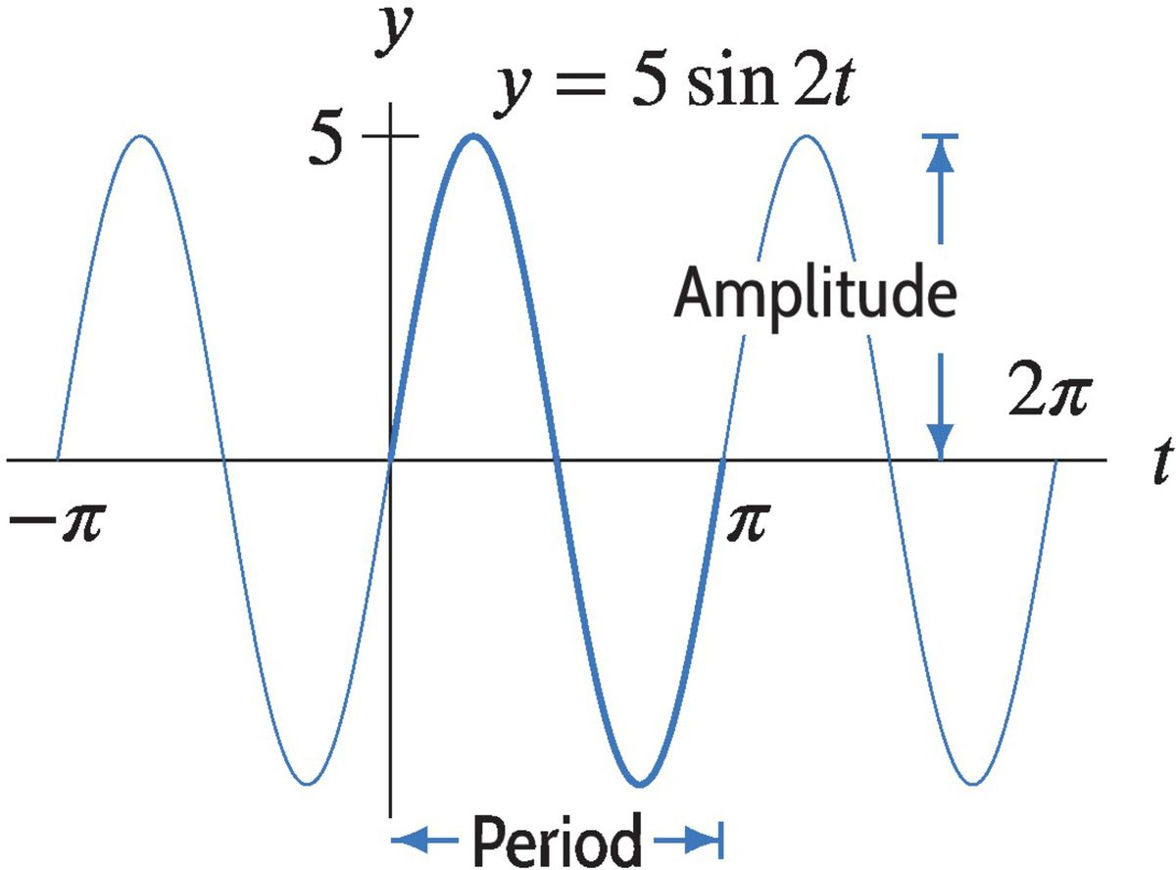
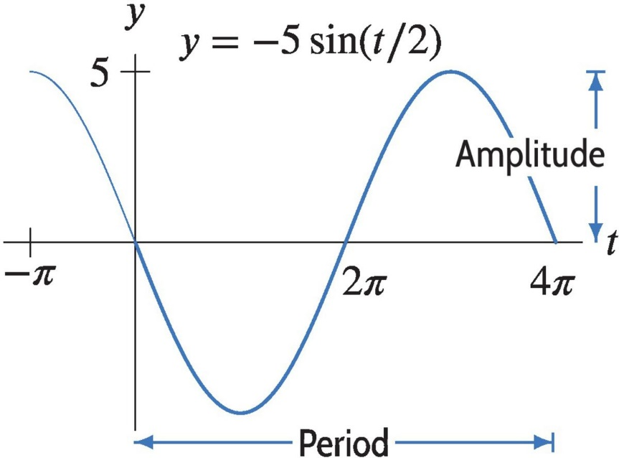
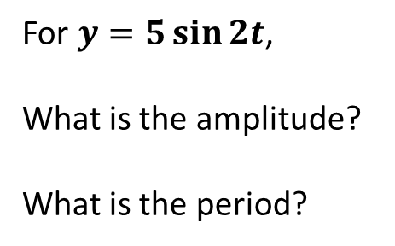

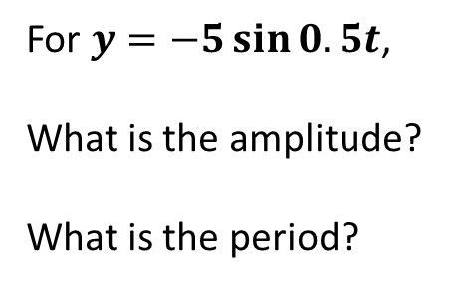

Sketch the Graph
For $y=5\sin{2t}$,
What is the amplitude?
What is the period?
For $y=−5\sin{0.5t}$,
What is the amplitude?
What is the period?
The amplitude is 5.
The amplitude is 5.
The period is $\frac{2π}{2}=π$.
The period is $\frac{2π}{0.5}=4π$.

Slide 7
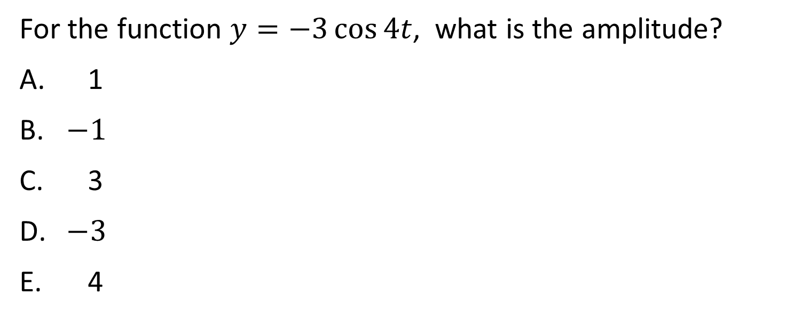
Question #1
For the function $y=−3\cos{4t}$, what is the amplitude?
1
$−1$
3
$−3$
4
The amplitude is the vertical stretch, which is the absolute value of this coefficient.
Solution
Answer: C

Slide 8
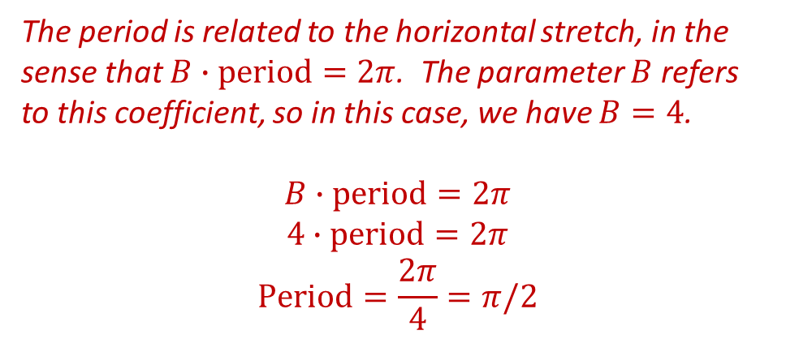
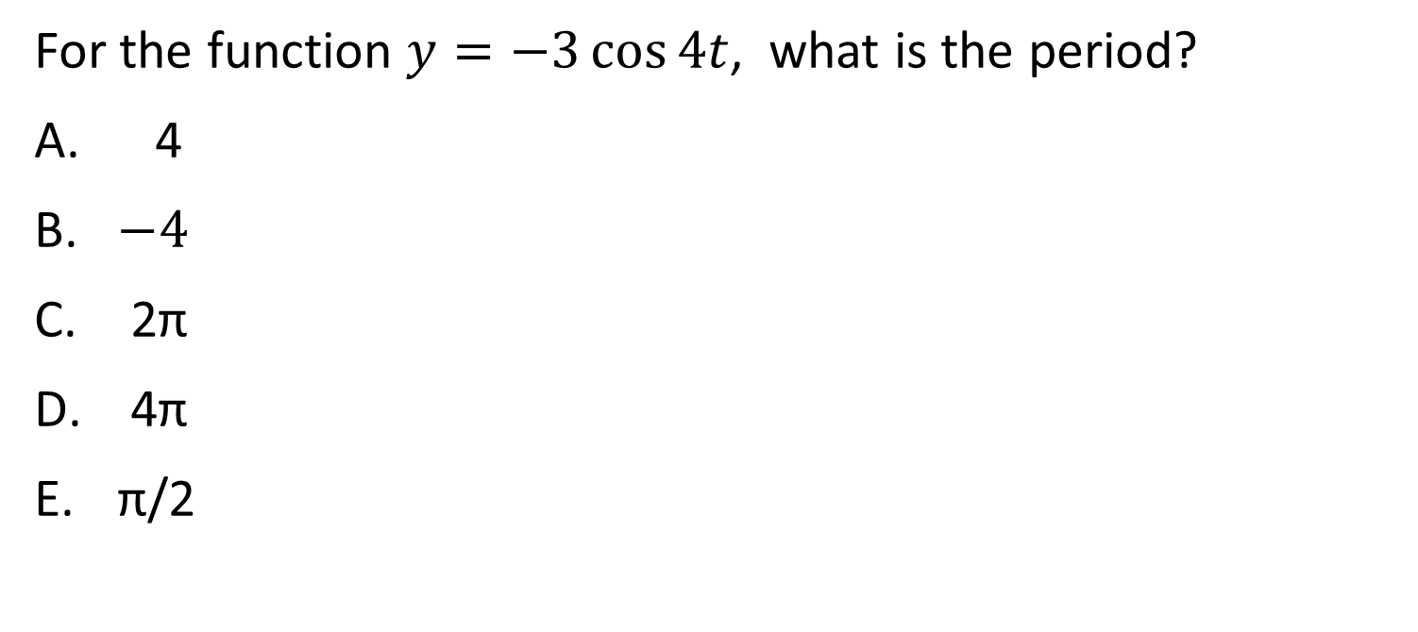
Question #2
For the function $y=−3\cos{4t}$, what is the period?
4
$−4$
2π
4π
π/2
The period is related to the horizontal stretch, in the sense that $B∙\text{period}=2π$. The parameter $B$ refers to this coefficient, so in this case, we have $B=4$.
$$B∙\text{period}=2π$$
$$4∙\text{period}=2π$$
$$\text{Period}=\frac{2π}{4}=π/2$$
Solution
Answer: E

Slide 9
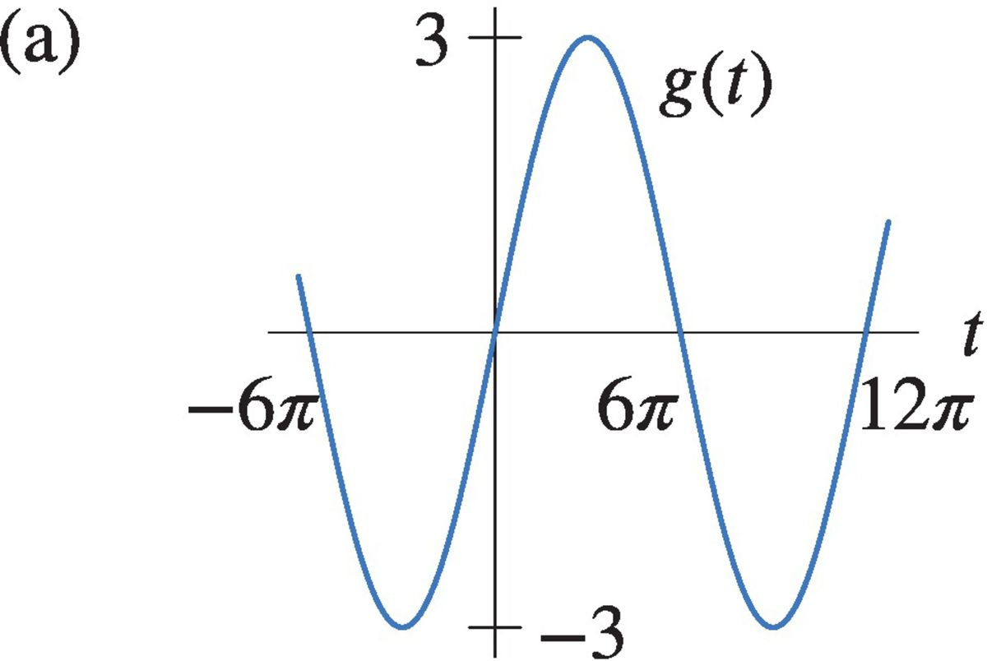
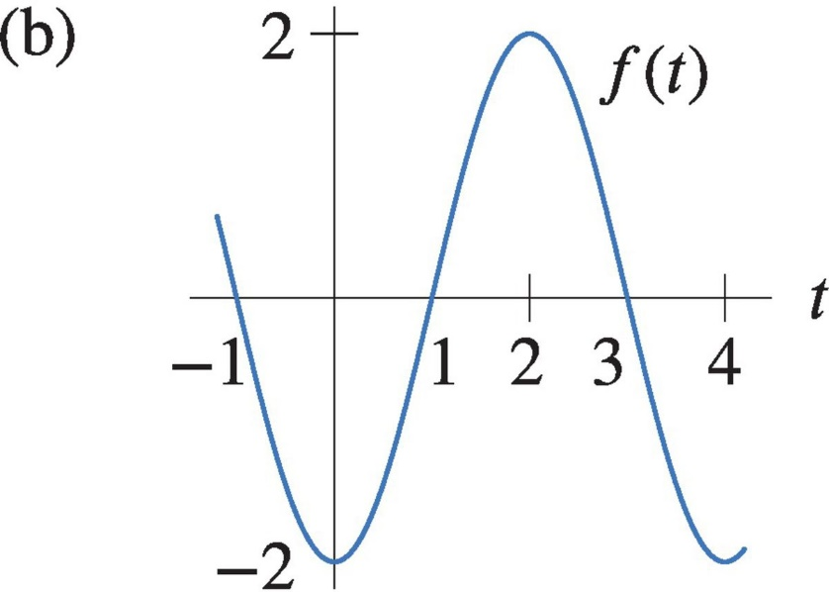
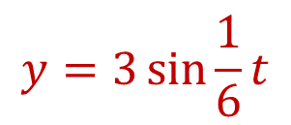
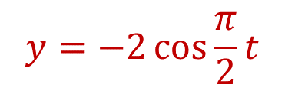
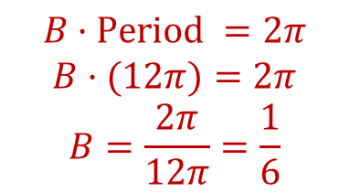
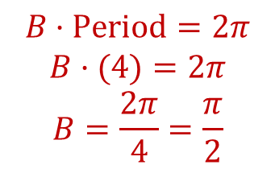






Finding Formulas from Graphs
Find formulas for the following trigonometric graphs.
Is this sin? -sin? cos? –cos?
$$y=A\sin{Bt}$$
Is this sin? -sin? cos? –cos?
$$y=−A\cos{Bt}$$
What is the amplitude?
$$y=3\sin{Bt}$$
What is the amplitude?
$$y=−2\cos{Bt}$$
What is the period?
What is the period?
$$y=3\sin{\frac{1}{6}t}$$
$$B·\text{Period} =2π$$
$$B·(12π)=2π$$
$$B=\frac{2π}{12π}=\frac{1}{6}$$
$$B·\text{Period}=2π$$
$$B·(4)=2π$$
$$B=\frac{2π}{4}=\frac{π}{2}$$
$$y=−2\cos{\frac{π}{2}t}$$
$$\text{Period}=12π$$
$$\text{Period}=4$$

Slide 10
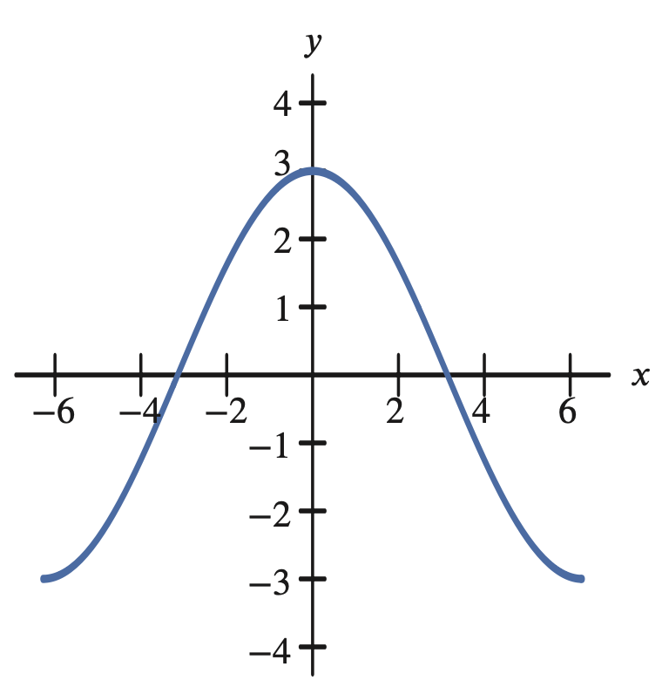
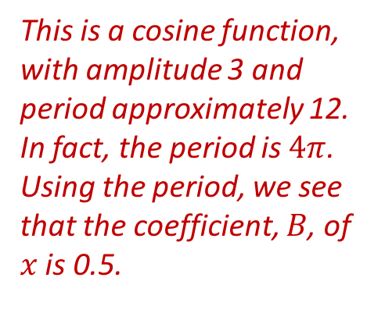
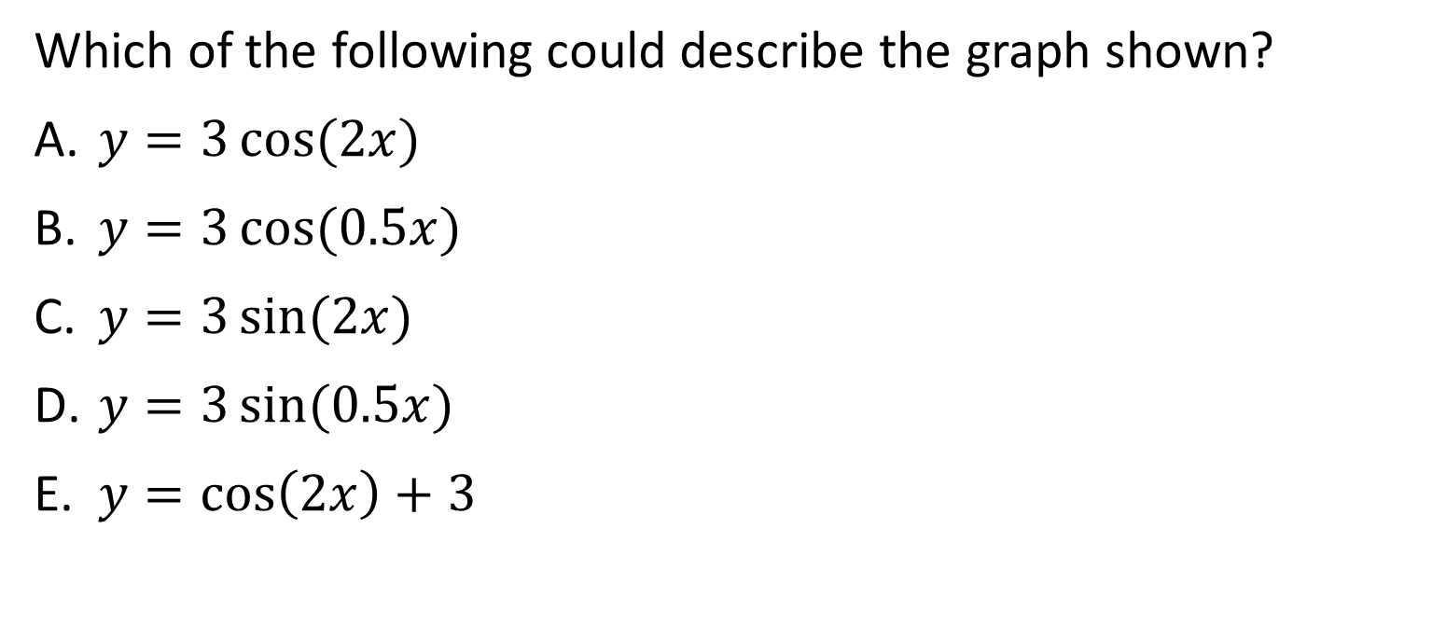
Question #3
Which of the following could describe the graph shown?
$y=3\cos{(2x)}$
$y=3\cos{(0.5x)}$
$y=3\sin{(2x)}$
$y=3\sin{(0.5x)}$
$y=\cos\left(2x\right)+3$
This is a cosine function, with amplitude 3 and period approximately 12. In fact, the period is $4π$. Using the period, we see that the coefficient, $B$, of $x$ is 0.5.
Solution
Answer: B

Slide 11
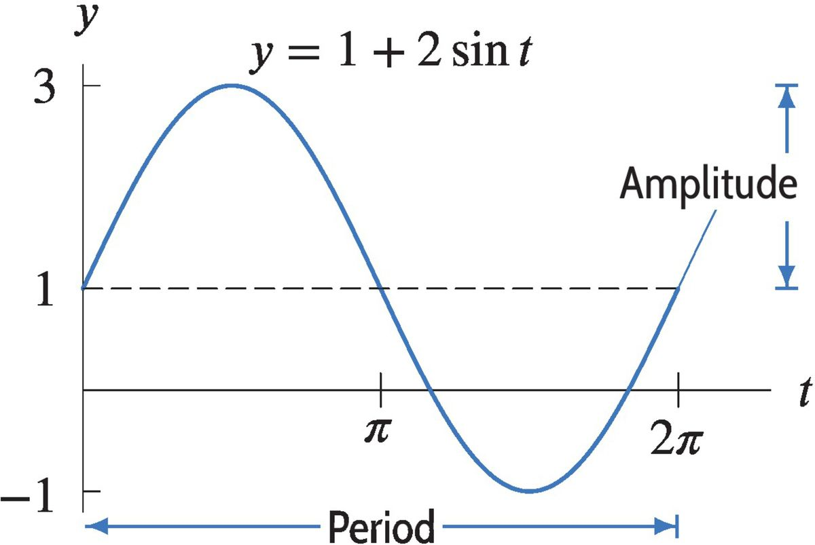


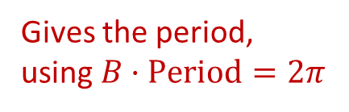
What About Vertical Shifts?
$$y=A\sin\left(Bt\right)+D$$
Gives the amplitude
Gives the vertical shift to the midline
Gives the period,
using $B·\text{Period}=2π$
Wave is +sin curve
Vertical shift is +1
Amplitude is 2
Period is 2π so B is 1
$$y=2\sin{t+1}$$

Slide 12
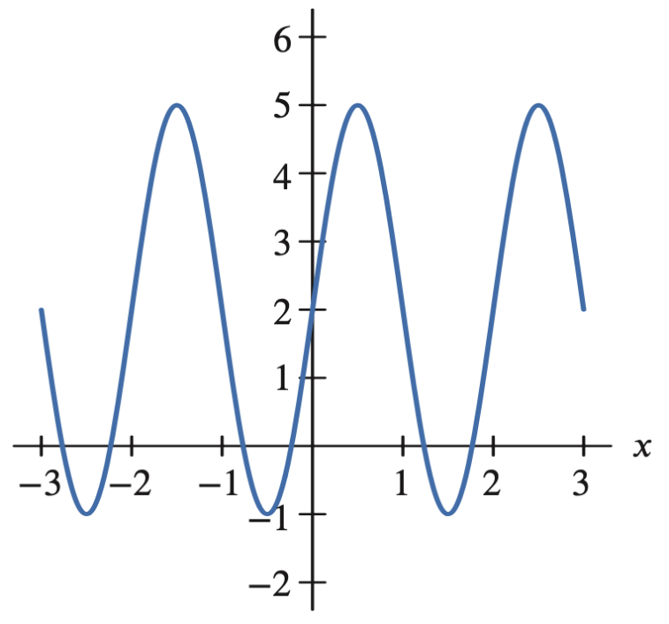
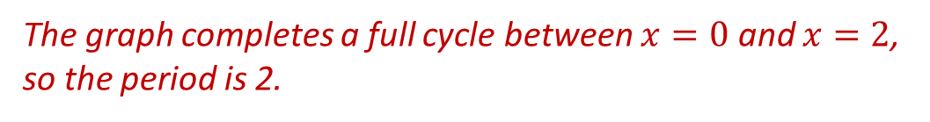
Question #4
What are the amplitude and period of the periodic function shown in the figure?
 | Amplitude | Period
(a) | 2 | 2
(b) | 2 | 3
(c) | 2 | 1/2
(d) | 3 | 2
(e) | 3 | 1/2
Solution
The range of this function is from $−1$ to $5$, so the midline is $y=2$.
The amplitude is 3.
The graph completes a full cycle between $x=0$ and $x=2$, so the period is 2.
Answer: D

Slide 13
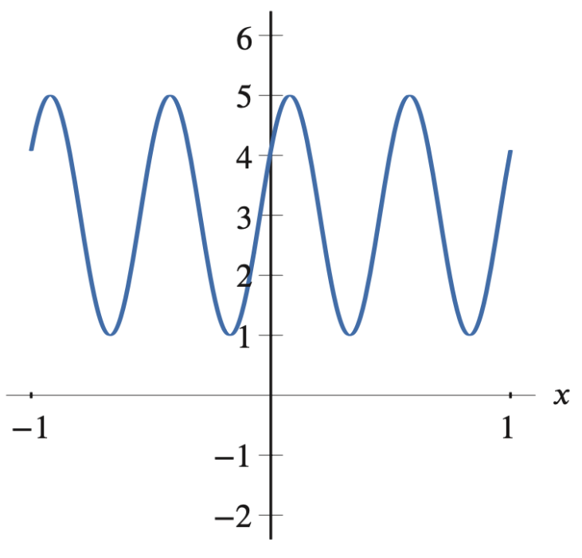
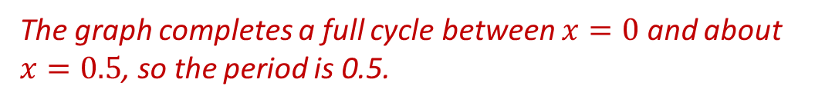
Question #5
What are the amplitude and period of the periodic function shown in the figure?
 | Amplitude | Period
(a) | 2 | 2
(b) | 2 | 3
(c) | 2 | 1/2
(d) | 3 | 2
(e) | 3 | 1/2
Solution
The range of this function is from $1$ to $5$, so the midline is $y=3$.
The amplitude is 2.
The graph completes a full cycle between $x=0$ and about $x=0.5$, so the period is 0.5.
Answer: C

Slide 14
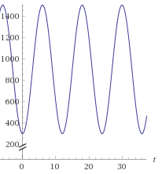
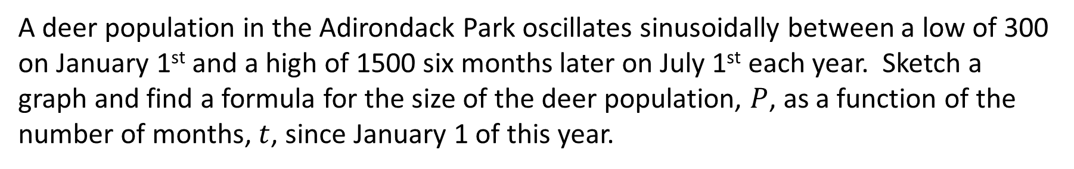
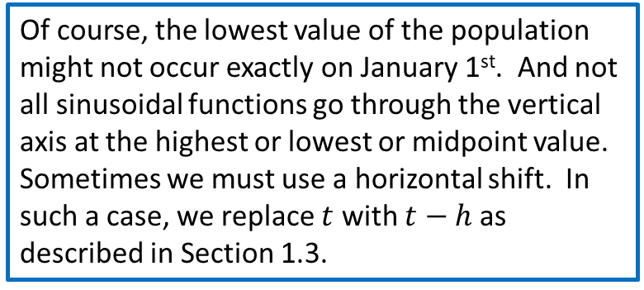
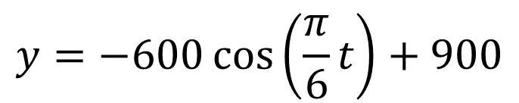
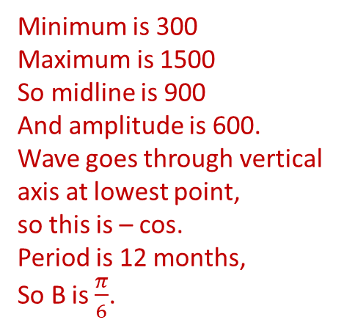
Modeling Deer Population
A deer population in the Adirondack Park oscillates sinusoidally between a low of 300 on January 1st and a high of 1500 six months later on July 1st each year. Sketch a graph and find a formula for the size of the deer population, $P$, as a function of the number of months, $t$, since January 1 of this year.
$$y=−600\cos\left(\frac{π}{6}t\right)+900$$
Minimum is 300
Maximum is 1500
So midline is 900
And amplitude is 600.
Wave goes through vertical axis at lowest point,
so this is – cos.
Period is 12 months,
So B is $\frac{π}{6}$.
Of course, the lowest value of the population might not occur exactly on January 1st. And not all sinusoidal functions go through the vertical axis at the highest or lowest or midpoint value. Sometimes we must use a horizontal shift. In such a case, we replace $t$ with $t−h$ as described in Section 1.3.

Slide 15
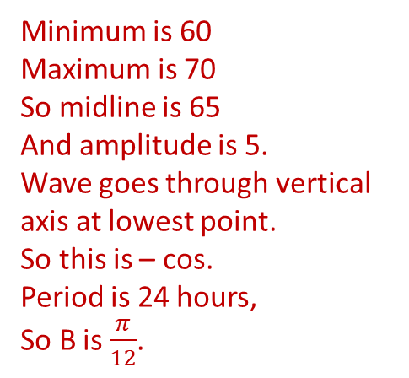
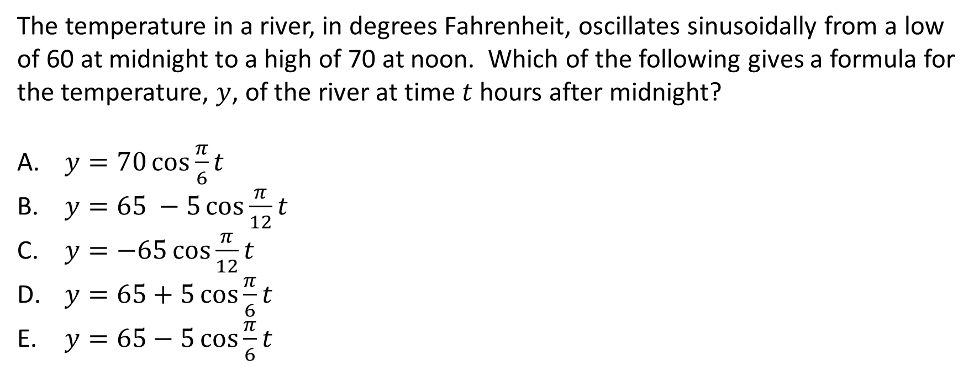
Question #6
The temperature in a river, in degrees Fahrenheit, oscillates sinusoidally from a low of 60 at midnight to a high of 70 at noon. Which of the following gives a formula for the temperature, $y$, of the river at time $t$ hours after midnight?
$y=70\cos{\frac{π}{6}t}$
$y=65 −5\cos{\frac{π}{12}t}$
$y=−65\cos{\frac{π}{12}t}$
$y=65+5\cos{\frac{π}{6}t}$
$y=65−5\cos{\frac{π}{6}t}$
Minimum is 60
Maximum is 70
So midline is 65
And amplitude is 5.
Wave goes through vertical axis at lowest point.
So this is – cos.
Period is 24 hours,
So B is $\frac{π}{12}$.
Solution
Answer: B

Slide 16
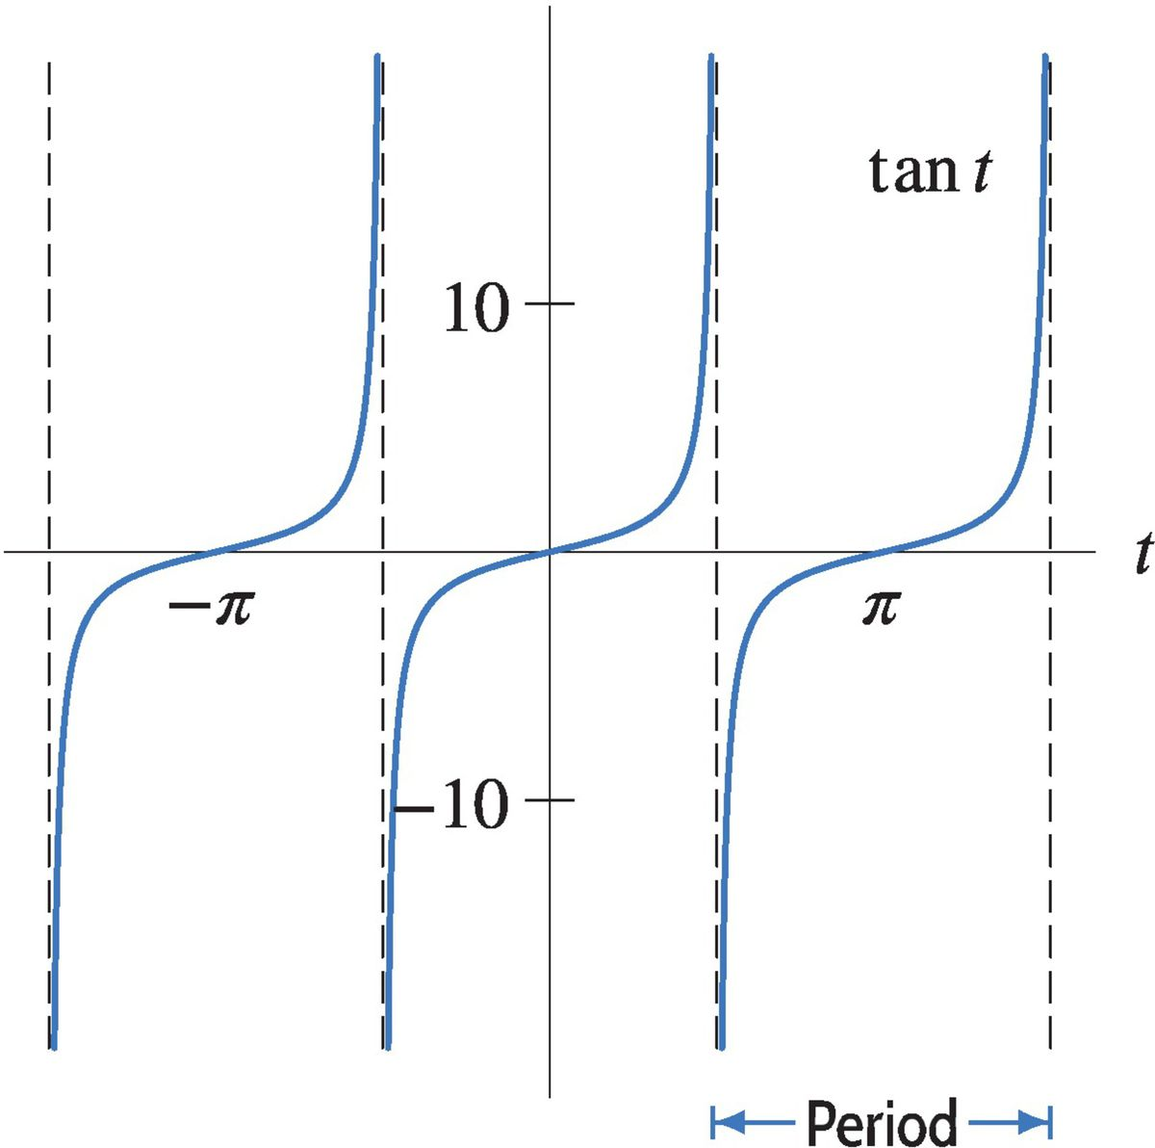
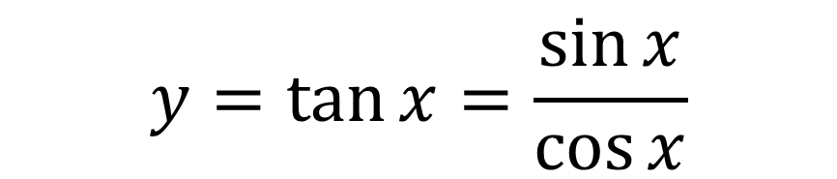
The Tangent Function
$$y=\tan{x}=\frac{\sin{x}}{\cos{x}}$$

Slide 17

Inverse Trig Functions
An inverse trig function “undoes” a trig function.
Note that the sine and cosine functions are not invertible, since a horizontal line might intersect the graph in infinitely many places! We need to restrict the domain of the function to define an inverse. Solutions in this domain are the preferred solutions and can be translated to find other solutions.
For $−1≤x≤1$, we define $y=\sin^{−1}x$ or $y=\arcsin{x}$ to mean $\sin{y=x}$, restricted to $\frac{−π}{2}≤y≤\frac{π}{2}$.
For $−1≤x≤1$, we define $y=\cos^{−1}x$ or $y=\arccos{x}$ to mean $\cos{y=x}$, restricted to $0≤y≤π$.
When using the appropriate domain and range, we have
$$\sin^{−1}{(\sin{x})}=x$$
and
$$\cos^{−1}{(cos{x})}=x$$

Slide 18
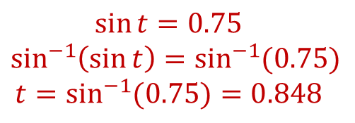
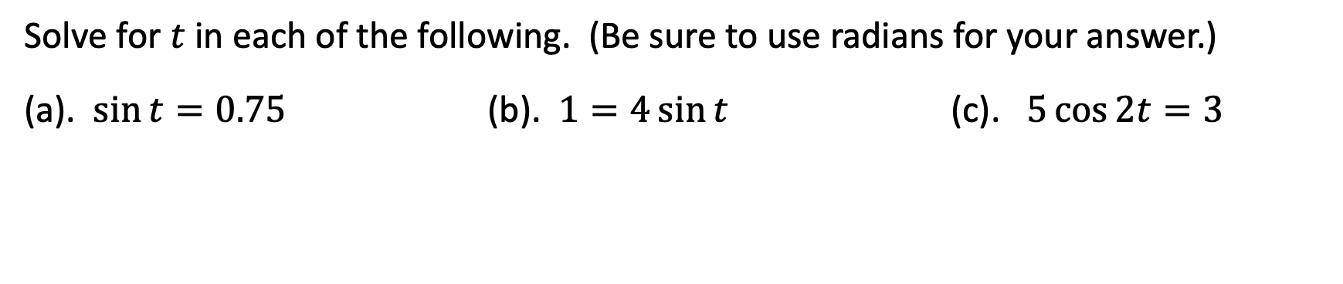
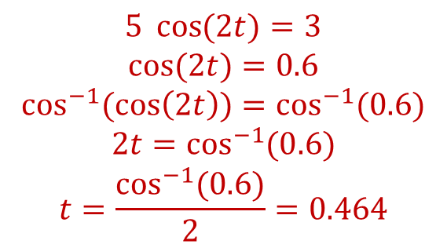
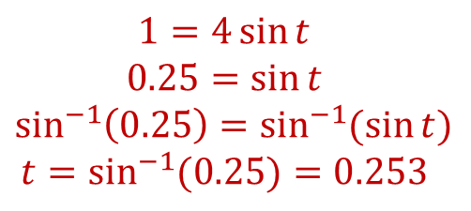
Solving Trig Equations
Solve for $t$ in each of the following. (Be sure to use radians for your answer.)
(a). $\sin{t}=0.75$ (b). $1=4\sin{t}$ (c). $5\cos{2t}=3$
$$\sin{t}=0.75$$
$$\sin^{−1}\left(\sin{t}\right)=\sin^{−1}{(0.75)}$$
$$t=\sin^{−1}{(0.75)}=0.848$$
$$1=4\sin{t}$$
$$0.25=\sin{t}$$
$$\sin^{−1}\left(0.25\right)=\sin^{−1}{(\sin{t})}$$
$$t=\sin^{−1}{(0.25)}=0.253$$
$$5 \cos{(2t)}=3$$
$$\cos{(2t)}=0.6$$
$$\cos^{−1}{(\cos\left(2t\right))}=\cos^{−1}{(0.6)}$$
$$2t=\cos^{−1}{(0.6)}$$
$$t=\frac{\cos^{−1}{(0.6)}}{2}=0.464$$
In every case, note that these are the preferred solutions.
Additional solutions can be found using translations.

Slide 19
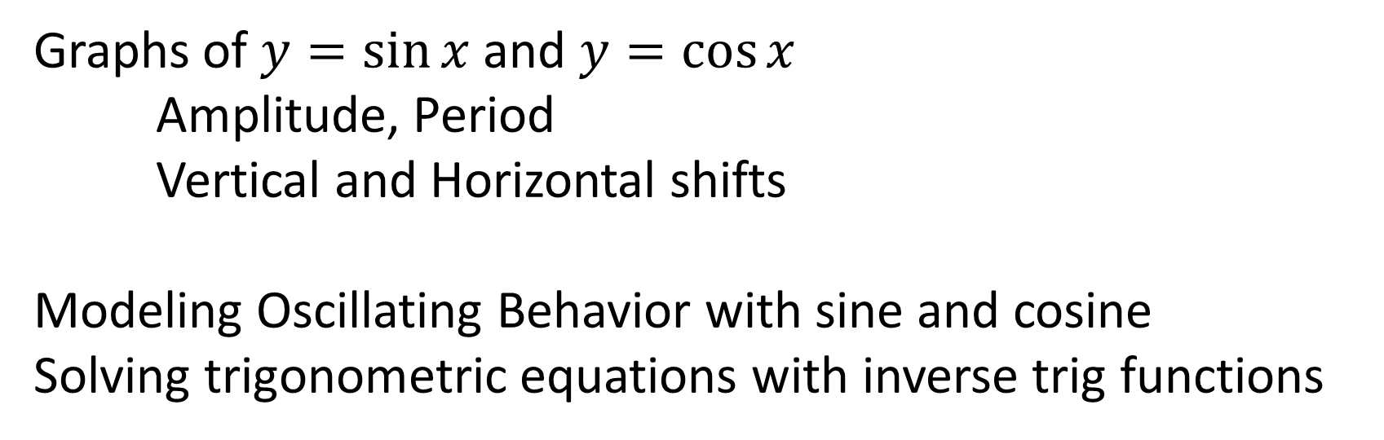
Summary
Graphs of $y=\sin{x}$ and $y=\cos{x}$
  Amplitude, Period
  Vertical and Horizontal shifts
Modeling Oscillating Behavior with sine and cosine
Solving trigonometric equations with inverse trig functions

